Slide 1
Module II
ALP, Procedures,Macro and Stack

Slide 2
Overview of Assembly Language
Advantages:
Faster as compared to programs written using high-level languages
Efficient memory usage
Control down to bit level
Disadvantages:
Need to know detail hardware implementation
Not portable
Slow to development and difficult to debug
Basic components in assembly Language:
Instruction, Directive, Label, and Comment

Slide 3
Program Statements
name operation operand(s) comment
Operation is a predefined or reserved word
mnemonic - symbolic operation code
directive - pseudo-operation code
Space or tab separates initial fields
Comments begin with semicolon
Most assemblers are not case sensitive

Slide 4
Assembling & Running A Program
Assembling a program
Use microsoft macro assembler (MASM)
MASM PRGM1.ASM
Translates the assembly file PROG1.ASM into machine language object file PROG1.OBJ
Creates a listing file PROG1.LST containing assembly language code and corresponding machine code.
Linking a program
The .OBJ file is a machine language file but cannot be run
Some addresses not filled since it is not known where a program will be loaded in memory.
Some names may not have been defined.
Combines one or more object files and creates a single executable file (.EXE).
LINK PROG1

Slide 5
Assembling & Running A Program
Running a program
Type the name of the program to load it and run it
Procedure
Masm prog1.asm
Link prog1.obj
Simplified procedure
ML PROG1.ASM
Assembles and links the program
Debugging a program
To analyze a program use DOS Debugger.
Debug PROG1
Use t to trace single instruction at a time.
For Int instructions use p .
Use q to quit.

Slide 6
Input and Output
CPU communicates with peripherals through I/O registers called I/O ports.
Two instructions access I/O ports directly: IN and OUT.
Used when fast I/O is essential.
Most programs do not use IN/OUT instructions
port addresses vary among computer models
much easier to program I/O with service routines provided by manufacturer
Two categories of I/O service routines
Basic input/output system (BIOS) routines
Disk operating system (DOS) routines
DOS [20h-3Fh ]and BIOS [0 - 1Fh] routines invoked by INT (interrupt) instruction.

Slide 7
Input/Output - Cont.
INT 21H used to invoke a large number of DOS function.
Type of called function specified by putting a number in AH register.
AH=01 single-key input with echo
AH=02 single-character output
AH=09 character string output
AH=08 single-key input without echo
AH=0Ah character string input
AH=4Ch return control to the operating system (stop program).

Slide 8
Single-Key Input
Input: AH=01
Output: AL= ASCII code if character key is pressed, otherwise 0.
To input character with echo:
MOV AH,01
INT 21H ; read character will be in AL register
To input a character without echo:
MOV AH, 08
INT 21H ; read character will be in AL register

Slide 9
Single-Character Output
Input: AH=02, DL= ASCII code of character to be output
Output: AL=ASCII code of character
To display a character
MOV AH, 02
MOV DL, ‘?’ ; displaying character ‘?’
INT 21H
To read a character and display it
MOV AH, 01
INT 21H
MOV AH, 02
MOV DL, AL
INT 21H

Slide 10
Displaying a String
Input: AH=09, DX= offset address of a string.
String must end with a ‘$’ character.
To display the message Hello!
MSG DB “Hello!$”
MOV AH, 09
MOV DX, offset MSG
INT 21H
OFFSET operator returns the address of a variable
The instruction LEA (load effective address) loads destination with address of source
LEA DX, MSG

Slide 11
Inputting a String
Input: AH=0AH, DX= offset address of a buffer to store read string.
First byte of buffer should contain buffer size.
Second byte of buffer reserved for storing number of chars actually read
This function does not add '$' in the end of string. to print using INT 21h / AH=09H, you must set dollar character at the end of it and start printing from address DS:DX + 2.
To read a Name of maximum size of 20 & display it
Name DB 20,0,20 dup($)
MOV AH, 0AH
LEA DX, Name
INT 21H
MOV AH, 09H
LEA DX, Name+2
INT 21H

Slide 12
Program to display the string HELLO
Data1 Segment
Message1 DB 0DH,0AH,’’HELLO$’’
Data1 Ends
Code1 Segment
Assume CS: Code1,DS:Data1
Start: Mov AX, Data1 ; Initialize DS
Mov DS,AX
Lea DX,Message1
Mov AH,09H
Int 21H
Mov AH,4CH
Int 21H
Code1 ENDS
END Start

Slide 13
Program to Add array of data using JUMP instruction

Slide 14
Program Segments
Data segment
Example: offset of data at 0200H
Add 5 bytes of data: 25H, 12H, 15H, 1FH, 2BH
using data segment with an offset register
Program:
MOV AL,0
MOV BX,0200H
MOV CL, 05H
MOV DL, 00H
BACK: ADD AL,[BX]
INC BX
JNC: NEXT
INC DL
NEXT: DEC CL
JNZ : BACK
MOV [BX], AL
INC BX
MOV [BX], DL

Slide 15
A Case Conversion Program
Prompt the user to enter a lowercase letter, and on next line displays another message with letter in uppercase.
Enter a lowercase letter: a
In upper case it is: A
LEA DX, MSG1 ; display first message
MOV AH, 09
INT 21H
MOV AH, 01 ; read character
INT 21H
SUB AL, 20H ; convert it to upper case
LEA DX, MSG2 ; display second message and
MOV AH, 09 ; uppercase letter
INT 21H
MOV DL, AL ;
MOV AH,02H
INT 21H
MOV AH,4CH
INT 21H ; return to DOS
CODE ENDS
END START
DATA SEGMENT
CR EQU 0DH
LF EQU 0AH
MSG1 DB ‘Enter a lower case letter: $’
MSG2 DB CR, LF, ‘In upper case it is: ‘$’
DATA ENDS
CODE SEGMENT
ASSUME CS: CODE, DS: DATA
START: MOV AX,DATA
MOV DS,AX ; initialize data segment

Slide 16
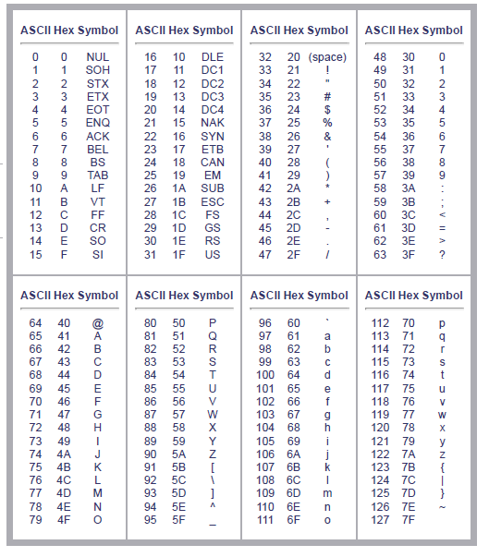
ASCII Code Table

Slide 17
MUL Application: Inputting a Decimal Number
Inputting a 2-digit decimal number
MOV AH, 01 ;read first digit
INT 21H
AND AL, 0F ; convert digit from ASCII code to binary
MOV BL, 10
MUL BL ; multiply digit by 10
MOV CL, AL
MOV AH, 01 ; read 2nd digit
INT 21H
AND AL, 0F ; convert digit from ASCII code to binary
ADD AL, CL ; AL contains the 2-digit number

Slide 18
DIV Application: Outputting a Decimal Number
Outputting a 2-digit decimal number in AX
MOV BL, 10
DIV BL ; getting least significant digit
OR AH, 30H ; converting L.S. digit to ASCII
MOV DH, AH ; storing L.S. digit temporarily
MOV AH, 00
DIV BL ; getting most significant digit
OR AH, 30H ; converting M.S. digit into ASCII
MOV DL, AH ; displaying M.S. digit
MOV AH, 02
INT 21H
MOV DL, DH ; displaying least significant digit
INT21H

Slide 19
Program to add two 16 bit Numbers
DATA SEGMENT
NUM DW 1234H, F234H
SUM DW 2 DUP (0)
DATA ENDS
CODE SEGMENT
ASSUME CS: CODE, DS: DATA
START: MOV AX, DATA
MOV DS, AX
MOV AX, NUM
CLC
MOV CX, 0000H
ADD AX, NUM+2
JNC DOWN
INC CX
DOWN: MOV SUM,AX
MOV SUM+2, CX
MOV AH, 4CH
INT 21H
CODE ENDS
END START
INPUT: 1234H, F234H
OUTPUT: 10468H
Notes:
Note: INT 21h / AH=4Ch - return control to the operating system (stop program).

Slide 20
Program to subtract two 16 bit Numbers
DATA SEGMENT
NUM DW 840CH, B2CAH
DIF DW ?
SIGN BIT DB ?
DATA ENDS
CODE SEGMENT
ASSUME CS: CODE, DS: DATA
START: MOV AX, DATA
MOV DS, AX
CLC
XOR CX,CX; Clear CX
MOV AX, NUM
SUB AX, NUM+2
JNC STORE
INC CL
NEG AX; 2’S COMPLEMENT
if negative result
STORE: MOV DIF,AX
MOV SIGN BIT ,CL
MOV AH, 4CH
INT 21H
CODE ENDS
END START
INPUT: 840CH,B2CAH
OUTPUT: 2EBEH
SIGN BIT=01H

Slide 21
Program to add two BCD numbers
DATA SEGMENT
NUM DW 4578,8598
SUM DW ?
CARRY BIT DB ?
DATA ENDS
CODE SEGMENT
ASSUME CS: CODE, DS: DATA
START: MOV AX, DATA
MOV DS, AX
CLC
XOR CX,CX
LEA SI,NUM
MOV AX, [SI]
MOV BX, [SI+2]
ADD AL,BL
DAA;BCD ADJUST
MOV DL,AL
MOV AL,AH
ADC AL,BH
DAA
MOV DH,AL
JNC STORE
INC CL
STORE:MOV SUM,DX
MOV CARRY BIT ,CL
MOV AH, 4CH
INT 21H
CODE ENDS
END START
OUTPUT: 3176
CARRY BIT=01H
SUM=013176

Slide 22
Program to subtract two BCD numbers
DATA SEGMENT
NUM DW 9572,4793
DIFF DW ?
BORROW BIT DB ?
DATA ENDS
CODE SEGMENT
ASSUME CS: CODE, DS: DATA
START: MOV AX, DATA
MOV DS, AX
CLC
XOR CX,CX
LEA SI,NUM
MOV AX, [SI]
MOV BX, [SI+2]
SUB AL,BL
DAS;BCD ADJUST
MOV DL,AL
MOV AL,AH
SBB AL,BH
DAS
MOV DH,AL
JNC STORE
INC CL
STORE:MOV DIFF,DX
MOV BORROW BIT ,CL
MOV AH, 4CH
INT 21H
CODE ENDS
END START
OUTPUT: 4779
CARRY BIT=00H
DIFF=004779

Slide 23
Program to multiply two 16 bit Numbers
DATA SEGMENT
NUM DW 1234H, F234H
PROD DW 2 DUP (0)
DATA ENDS
CODE SEGMENT
ASSUME CS: CODE, DS: DATA
START: MOV AX, DATA
MOV DS, AX
MOV DX, 00H
LEA SI, NUM
MOV AX, [SI]
MUL AX, [SI+2]
MOV PROD, AX
MOV PROD+2, DX
MOV AH, 4CH
INT 21H
CODE ENDS
END START

Slide 24
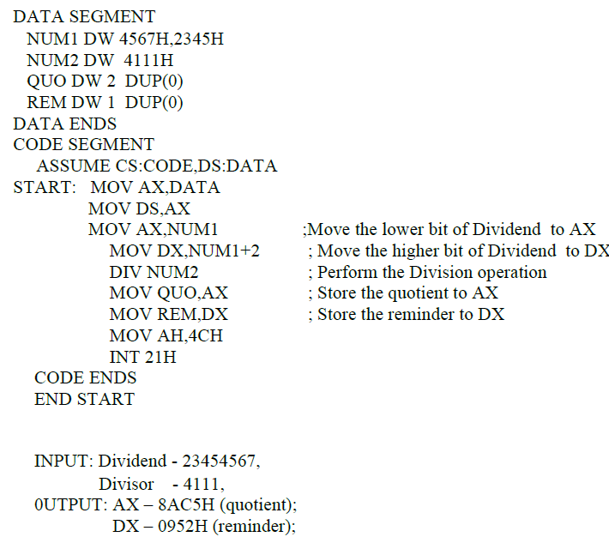
32 Bit Division for Unsigned numbers

Slide 25
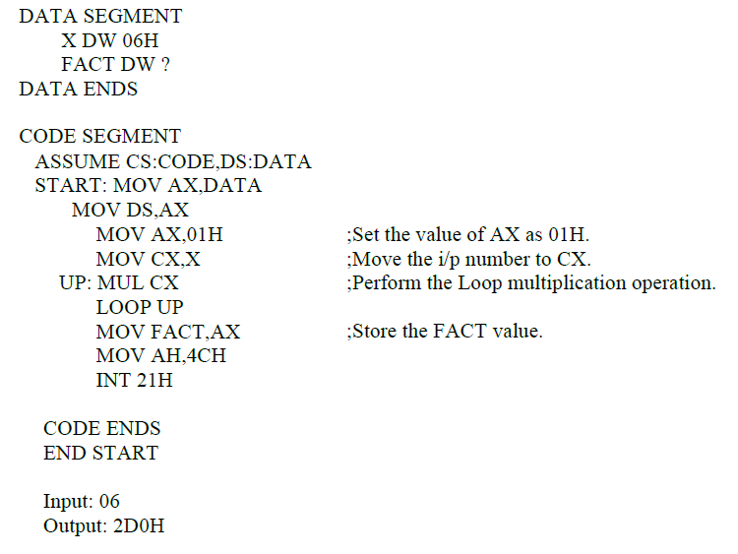
Program to find factorial of a given number

Slide 26
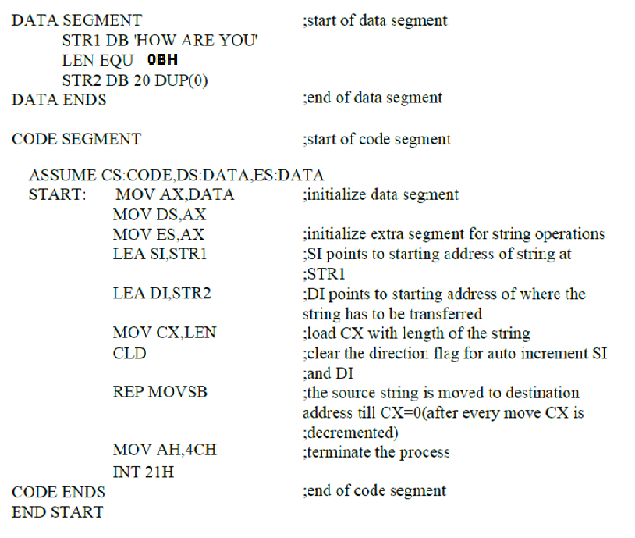
PROGRAM FOR STRING TRANSFER

Slide 27
Program to reverse a string
DATA SEGMENT
STR1 DB 'HELLO‘
STR2 DB 20 DUP(0)
LEN EQU 05H
DATA ENDS
CODE SEGMENT
ASSUME CS:CODE, DS:DATA, ES:DATA
START: MOV AX,DATA ;initialize data segment and extra segment for string operations
MOV DS,AX
MOV ES,AX
LEA SI,STR1 ;SI points to the starting address of the string at STR1
LEA DI,STR2+LEN-1;DI points to the address of the last character in the string(here address of ‘o')
MOV CX,LEN ;load CX with count value equal to number of characters in the string
UP: CLD ;clear the direction flag to auto increment SI
LODSB ;load AX with the character pointed SI register
STD ;set the direction flag to auto decrement DI register
STOSB ;the contents of AX is stored at the address pointed by DI
LOOP UP ;decrement CX and continue the transfer till CX is zero
MOV AH,4CH
INT 21H ;terminate the process
CODE ENDS OUTPUT: OLLEH
END START

Slide 28
Program to search for a character in a string
DATA SEGMENT
MSG DB 'HELLO'
CNT EQU 05H
SRC EQU 'E'
;start of data segment
MSG1 DB 10,13,'CHARACTER FOUND$'
MSG2 DB 10,13,'CHARACTER NOT FOUND$'
DATA ENDS
LEA DX,MSG2
MOV AH,09H
INT 21H
JMP EXIT
DOWN: LEA DX,MSG1 ;if the character is found
MOV AH,09H ; display the message
INT 21H
EXIT: MOV AH,4CH
INT 21H
CODE ENDS
END START
OUTPUT: CHARACTER FOUND
CODE SEGMENT
ASSUME CS:CODE,DS:DATA,ES:DATA
START: MOV AX,DATA
MOV DS,AX
MOV ES,AX
LEA SI,MSG
MOV AL,SRC
MOV CL,CNT
MOV CH,00H
CLD
UP: SCASB
JZ DOWN
LOOP UP

Slide 29
PROGRAM TO CHECK FOR PALINDROME
DATA SEGMENT
STR1 DB 'LIRIL'
LEN EQU 05H
STR2 DB 20 DUP(0)
MES1 DB 10,13,'WORD IS PALINDROME$'
MES2 DB 10,13,'WORD IS NOT PALINDROME$'
DATA ENDS
CODE SEGMENT
ASSUME CS:CODE,DS:DATA,ES:DATA
START: MOV AX,DATA
MOV DS,AX
MOV ES,AX
LEA SI,STR1
LEA DI,STR2+LEN-1
MOV CX,LEN
UP: CLD
LODSB
STD
STOSB
LOOP UP
LEA SI,STR1
LEA DI,STR2
CLD
MOV CX,LEN
REPE CMPSB
CMP CX,0H
JNZ NOTPALIN
LEA DX,MES1
MOV AH,09H
INT 21H
JMP EXIT
NOTPALIN: LEA DX,MES2
MOV AH,09H
INT 21H
EXIT: MOV AH,4CH
INT 21H
CODE ENDS
END START
OUTPUT: WORD IS PALINDROME

Slide 30
Modular Programming
Many programs are too large to be developed by one person. This means that programs are routinely developed by teams of programmers.
The Linker program is used so that programming modules can be linked together into a complete program.
The assembler program converts a symbolic source module (file) into a hexadecimal object file.
The linker program, reads the object files that are created by the assembler program and links them together into a single execution file.
An execution file is created with the file name extension EXE.
If a file is short enough (less than 64K bytes long), it can be converted from an execution file to a command file (.COM).
The command file is slightly different from an execution file in that the program must be originated at location 0100H before it can execute.

Slide 31
Modular Programming (CONT..)
Object file1
.obj
Program
.asm
Assembler
Object file2
.obj
Linker
Executable file
.exe
Object file3
.obj

Slide 32
Modular Programming (CONT..)
The PUBLIC and EXTRN directives are very important to modular programming because they allow communications between modules.
We use PUBLIC to declare that labels of code, data, or entire segments are available to other program modules.
EXTRN (external) declares that labels are external to a module.
The PUBLIC directive is placed in the opcode field of an assembly language statement to define a label as public, so that the label can be used (seen by) by other modules.
The label declared as public can be a jump address, a data address, or an entire segment.
When segments are made public, they are combined with other public segments that contain data with the same segment name.

Slide 33
Subroutines (Procedures)
A Subroutine(Procedure) is a part of code that can be called from your program in order to make some specific task. Procedures make program more structural and easier to understand.
The branch to a subroutine is referred to as CALL and the corresponding branch back is known as RETURN.
The return is always made to the instruction immediately following the call.

Slide 34
Subroutine/Procedure
syntax for procedure declaration:
name PROC
…………. ; here goes the code
…………. ; of the procedure ...
RET
name ENDP
here PROC is the procedure name.(used in top & bottom)
PROC & ENDP – Assembler directives
CALL & RET - instructions

Slide 35
Subroutines provide the primary means of breaking the code in a program to modules.
Requirements of subroutine:
1) A procedure CALL must save the address of the next instruction , so that the return will be able to branch back to the proper place in the calling program.
2) The registers used by the procedure need to be stored before their contents are changed and then restored just before the procedure is exited.

Slide 36
Sub Routine Eg.
DATA Segment
num1 dw 22
num2 dw 32
result dw 0
DATA Ends
Assume CS:CODE,DS:DATA
CODE Segment
addnum proc
mov ax, [num1]
mov bx, [num2]
add ax, bx
mov [result], ax
ret
addnum endp
start: mov ax, DATA mov ds, ax
call addnum ; add num1
;and num2 mov ax, 4c00h
int 21h
CODE Ends
END start

Slide 37
The CALL and RET instructions
The CALL Instruction:
Stores the address of the next instruction to be executed after the CALL instruction to stack. This address is called as the return address.
Then it changes the content of the instruction pointer register and in some cases the content of the code segment register to contain the starting address of the procedure.

Slide 38
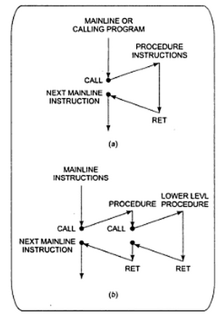
The CALL and RET instructions(contd.)
Chart for CALL and RET instruction →

Slide 39
The CALL and RET instructions(contd.)
Types of CALL instructions:
DIRECT WITHIN-SEGMENT NEAR CALL: produce the starting address of the procedure by adding a 16-bit signed displacement to the contents of the instruction pointer.
INDIRECT WITHIN-SEGMENT NEAR CALL: the instruction pointer is replaced with the 16-bit value stored in the register or memory location.
THE DIRECT INTERSEGMENT FAR CALL: used when the called procedure is in different segment. The new value of the instruction pointer is written as bytes 2 and 3 of the instruction code. The low byte of the new IP value is written before the high byte.
THE INDIRECT INTERSEGMENT FAR CALL: replaces the instruction pointer and the contents of the segment register with the two 16-bit values from the memory.

Slide 40
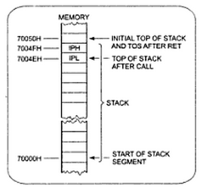
The 8086 Stack
Section of memory you set aside for storing return addresses.
Also used to store the contents of the registers for the calling program while a procedure executes.
Hold data or address that will be acted upon by procedures.

Slide 41
Using PUSH and POP
The PUSH register/memory instruction decrements the stack pointer by 2 and copies the contents of the specified 16-bit register or memory location to memory at the new top-of-stack location.
The POP register/memory instruction copies the word on the top-of-stack to the specified 16-bit register or memory location and increments the stack pointer by 2.

Slide 42
Passing parameters to procedures
Major ways of passing parameters to and from a procedure:
Using global declared variable
Using registers
Using dedicated memory locations accessed by name
Using stack
Using PUBLIC and EXTRN

Slide 43
Using global declared variable
A variable may be declared global in the main program and the same variable can be used by all the routines or procedures of the application.
Assume CS:Code1, DS:Data
Data Segment
Number EQU 77H Global
Data Ends
Code1 Segment
Start: Mov AX,Data
Mov DS,AX
.
.
.
Mov AX,Number
.
Code1 Ends
Assume CS:Code2
Code2 Segment
Start: Mov AX,Data
Mov DS,AX
Mov BX,Number
.
.
.
Code2 Ends
End Start

Slide 44
Using registers
Assume CS: Code
Code Segment
Start: Mov AX,5555H
Mov BX,7272H
.
.
Call Procedure1
.
.
.
Procedure1 Proc Near
.
.
Add AX,BX
.
.
Ret
Procedure1 Endp
Code Ends
End Start
The main program may store the parameters to be passed to the procedure in the available CPU registers and the procedure may use the same register contents for execution.
The original contents of the used CPU register may change during execution of the procedure.
This may be avoided by pushing all the register content to be used to the stack sequentially at the start of the procedure and by popping all the register contents at the end of the procedure in opposite sequence.

Slide 45
Using dedicated memory locations accessed by name
A main program may store the parameter to be passed to a procedure at a known memory address location and the procedure may use the same location for accessing the parameter.
Assume CS:Code,DS:Data
Data Segment
Num DB 55 H
Count EQU 10H
Data Ends
Code Segment
Start: Mov AX,Data
Mov DS,AX
.
.
Call Routine
.
.
Routine Proc Near
Mov BX,Num
Mov CX,Count
.
.
Routine Endp
Code Ends
End Start

Slide 46
Using stack
Stack memory can also be used to pass parameters to a procedure.
A main program may store the parameters to be passed to a procedure in its CPU registers.
The registers will further be pushed on to the stack.
The procedure during its execution pops back the appropriate parameters as and when required.
Stack Segment
Stackdata DB 200 DUP(?)
Stack Ends
Code Segment
Assume CS: Code, SS:Stack
Start: Mov AX,Stack
Mov SS,AX
Mov AX,5577H
Mov BX,2929H
.
Push AX
Push BX
Call Routine ; Decrements ;SP by 2
;(by 4 for Far routine)
.
.
Routine Proc Near
.
.
Mov DX,SP
Add SP, 02
Pop BX
Pop AX
Mov SP,DX
.
.
Routine Endp
Code Ends
End Start

Slide 47
Using PUBLIC and EXTRN
For passing the parameters to procedures using the PUBLIC and EXTRN directives, it must be declared public in the main routine and the same should be declared EXTRN in the procedure.
Thus the main program can pass the PUBLIC parameter to a procedure in which it is declared EXTRN.
Assume CS: Code, DS:Data
Data Segment
Public Number EQU 200H
Data Ends
Code Segment
Start: Mov AX,Data
Mov DS,AX
.
.
Call Routine
.
.
Routine Proc Near
Extrn Number
Mov AX,Number
.
.
.
Routine Endp

Slide 48
Writing and using Assembler Macros

Slide 49
Macros are just like procedures, but not really.
Macros exist only until your code is assembled
After assembling all macros are replaced with real instructions
several macros to make coding easier(Reduce large & complex programs)
Example (Macro definition)
name MACRO [parameters,...]
<instructions>
ENDM

Slide 50
Macros
A macro is a group of instructions that perform one task, just as a procedure performs one task.
The difference is that a procedure is accessed via a CALL instruction, whereas a macro, and all the instructions defined in the macro, is inserted in the program at the point of usage.
Creating a macro is very similar to creating a new opcode, which is actually a sequence of instructions, in this case, that can be used in the program.
You type the name of the macro and any parameters associated with it, and the assembler then inserts them into the program.
Macro sequences execute faster than procedures because there is no CALL or RET instruction to execute.
The instructions of the macro are placed in your program by the assembler at the point where they are invoked.

Slide 51
Macros (CONT..)
The MACRO and ENDM directives delineate a macro sequence.
The first statement of a macro is the MACRO instruction, which contains the name of the macro and any parameters associated with it.
An example is MOVE MACRO A,B
which defines the macro name as MOVE. This new pseudo opcode uses two parameters: A and B.
The last statement of a macro is the ENDM instruction, which is placed on a line by itself.
Never place a label in front of the ENDM statement. If a label appears before ENDM, the macro will not assemble.
Syntax:
<Macro-name> MACRO [<Arg 1> <,Arg 2>…<,Arg n>]
..
ENDM

Slide 52
Example1 : Macro Definitions
SAVE MACRO definition of MACRO name SAVE
PUSH AX
PUSH BX
PUSH CX
ENDM
RETREIVE MACRO Another definition of MACRO name RETREIVE
POP CX
POP BX
POP AX
ENDM

Slide 53
The following examples illustrate the use of macros.
Program with macro invocations:
SAVE
MOV CX, DA1
MOV BX, DA2
ADD AX, BX
ADD AX, CX
MOV DA2, AX
RETRIEVE

Slide 54
When the Macro Preprocessor expands the macros in the above source, the expanded source looks as shown below:
PUSH AX
PUSH BX
PUSH CX
MOV CX, DA1
MOV BX, DA2
ADD AX, BX
ADD AX, CX
MOV DA2, AX
POP CX
POP BX
POP AX

Slide 55
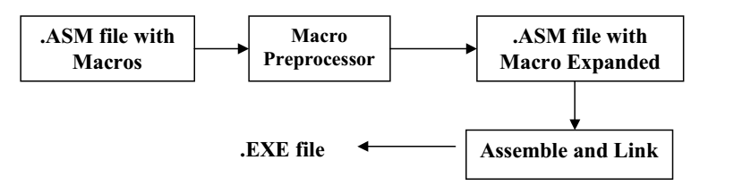

Slide 56
MACROS with Parameters
Example:
COPY MACRO x, y ; macro named COPY with
2 parameters{x, y}
PUSH AX
MOV AX, x
MOV y, AX
POP AX
ENDM

Slide 57
The macro is invoked in the following code with actual parameters as VAR1 and VAR2. Thus during the macro expansion, the parameter 1 is replaced by VAR1 and the parameter 2 is replaced by VAR2.
COPY VAR1, VAR2
The expanded code is:
PUSH AX
MOV AX, VAR1
MOV VAR2, AX
POP AX

Slide 58
Comparison Macros and Procedures
A big advantage of using procedures is that the machine codes for the group of instruction in the procedures needs to be loaded in to main memory only once.
Disadvantage using the procedures is the need for the stack.
A macro is the group of instruction we bracket and give a name to at the start of the program.
Using macro avoids the overhead time involved in calling and returning from a procedures.
Disadvantage is that this will make the program take up more memory than using a procedure.

Slide 59
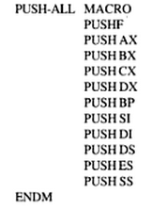
Defining and calling a Macro without parameters

Slide 60
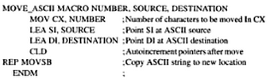
Passing parameters to Macros
The words NUMBER, SOURCE and DESTINATION are called as the dummy variables. When we call the macro, values from the calling statements will be put in the instruction in place of the dummies.

Slide 61
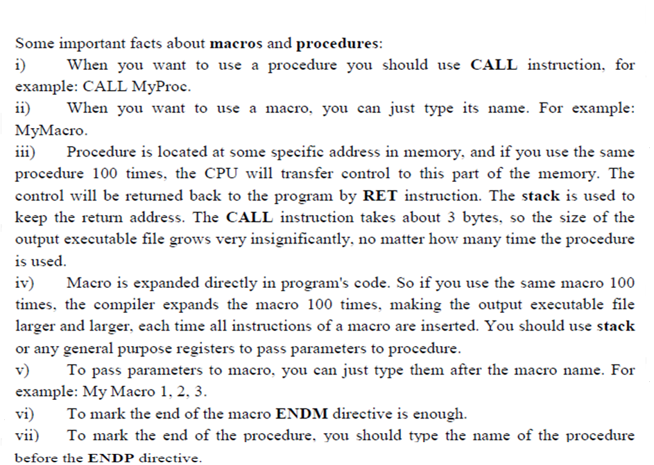

Slide 62
Stack and Subroutine

Slide 63
Stack
Is a section of memory set aside for storing return addresses.
It is also used to save the contents of registers for the calling program while a procedure executes.
Another use of stack is to hold data or addresses that will be acted upon by a procedure.

Slide 64
The 8086 lets us set aside up to an entire 64 kb of memory as stack.
It uses 2 registers - SS and SP.
SS-hold the upper 16 bits of the starting address given to the stack segment.
SP-hold the offset of the last word written on the stack.
8086 produces the physical address for a stack location by adding the offset contained in the SP register to the SS base address represented by the 16 bit number in the SS register.

Slide 65
PUSH & POP
Are 2 instructions that can operate on stack.
Push to Stack - PUSH SRC
Pop from stack- POP DST

Slide 66
Stack is an area of memory for keeping temporary data.
STACK is used by CALL & RET instructions.
PUSH -stores 16 bit value in the stack.
POP -gets 16 bit value from the stack.
PUSH and POP instruction are especially useful because we don't have too much registers to operate
Store original value of the register in stack (using PUSH).
Use the register for any purpose.
Restore the original value of the register from stack (using POP).

Slide 67
Example-1 (store value in STACK using PUSH & POP)
ORG 100h
MOV AX, 1234h
PUSH AX ; store value of AX in stack.
MOV AX, 5678h ; modify the AX value.
POP AX ; restore the original value of AX.
RET
END

Slide 68
Example 2: use of the stack is for exchanging the values
ORG 100h
MOV AX, 1212h ; store 1212h in AX.
MOV BX, 3434h ; store 3434h in BX
PUSH AX ; store value of AX in stack.
PUSH BX ; store value of BX in stack.
POP AX ; set AX to original value of BX.
POP BX ; set BX to original value of AX.
RET
END
push 1212h and then 3434h, on pop we will first get 3434h and only after it 1212h

